Slide 1
Lesson 304.7 - Subqueries

Slide 2
Section 1
__________________________
SQL Subqueries
‹#›
Learning Objectives:
In this lesson, you will learn how to use the SQL subquery to write complex queries and explain the correlated subquery concept.
By the end of this lesson, learners will be able to:
Describe subqueries.
Demonstrate how the subqueries and the correlated subquery depend on the outer query.

Slide 3
Prerequisite
Note: We will utilize a classicmodels database for demonstrations and examples in this presentation.

Slide 4
Table of Contents
‹#›
Subqueries.
Subqueries vs. JOINs.
Subqueries - Where Clause.
Subqueries - Having Clause.
Correlated Subqueries.
Subqueries with Data Manipulation Language.
What are Subqueries?
Where are Subqueries Used?
FROM Subqueries
WHERE Subqueries
HAVING Subqueries
Correlated Subqueries
Subqueries with DML

Slide 5
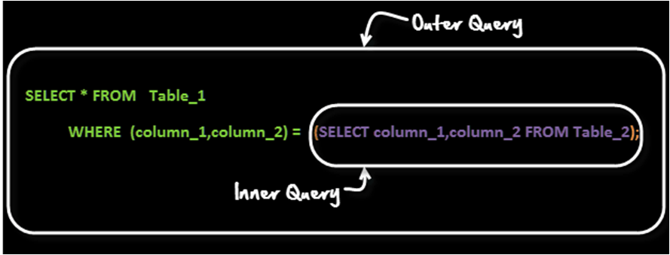
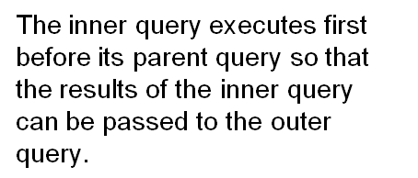
Subqueries
‹#›
Subqueries are SQL SELECT statements nested within other SQL statements. In other words, a subquery is a query within (embedded) a query — also referred to as an inner-query and INNER-SELECT. We can create subqueries, such as select, insert, update and delete, within your SQL statements.
Subqueries can be used in the FROM clause, the WHERE clause, or the HAVING clause; they make SQL more dynamic.
The embedded query “container” query is known as the outer query.

Slide 6
Subqueries (continued)
‹#›
SQL supports three types of subqueries, scalar subquery , row subquery and table subquery .
Scalar subqueries only return a single row and a single column. They can be used with comparison operators =, <, <=, >, or >=.
Row subqueries only return a single row but can have more than one column. They can be used with IN and Not IN operators.
Table subqueries can return multiple rows, as well as columns.
continue…

Slide 7
Subqueries (continued)
‹#›
Example:
Select checkNumber, amount from payments
where amount > (Select avg(amount) from payments);
We might know at any given time that the average amount is approximately $32,431.65, and could have written “where amount > 32431.65.” But that query would need to be updated every time a new payment was made. We can make our query dynamic by using a subquery.

Slide 8
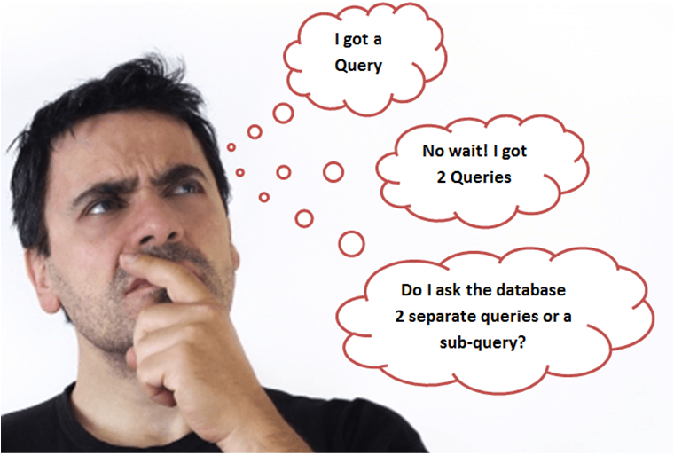
Subqueries vs. JOINs
‹#›
Subqueries and JOINs are both used to combine data from different tables into a single result. They share many similarities and differences. However, it is recommended to use a JOINs over a subquery for several reasons:
For performance issues, when it comes to getting data from multiple tables, it is strongly recommended to use JOINs instead of subqueries. Subqueries should only be used for this task for with good reason.
Subqueries should only be used as a fallback solution when you cannot use a JOIN operation.
By using JOINs, you can maximize the calculation burden on the database instead of on multiple queries using one join query. This means that you can make better use of the database’s abilities to search, filter, sort, etc.
However, the disadvantage of using JOINs is that they are not as easy to read as subqueries. Subqueries are more dynamic.
image source:coursera.org

Slide 9
Subqueries - WHERE Clause
‹#›
You can use the comparison operators, such as >, <, or =. The comparison operator can also be a multiple-row operator, such as IN, ANY, EXISTS, ALL, etc.
The power of using a subquery with the Where clause is that you do not have to hard-code values within the comparisons. You can rely on the subquery results.
The WHERE clause is used to specify the conditions to filter records. The rows will be filtered according to the comparison between the results of the subquery and the mentioned column.
Syntax: Subquery in WHERE Clause:
SELECT column_name(s)
FROM table_name_1
WHERE column_name comparison_operator { =,NOT IN,IN, <,>, etc }
(SELECT column_name(s) from table_name_2);

Slide 10
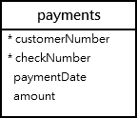
Example 1: - Subqueries - WHERE Clause
‹#›
Let’s consider the payment table diagram from the classicmodels database.
We might know that the average amount is $32,431.65, and could have been written as “where amount > 32431.65” condition. This amount is static, as shown below.
After a payment is made, the average amount could change. We need a dynamic solution to make our query dynamic. Let’s make above query more dynamic, as shown below:
Select checkNumber, amount from payments where amount > 32431.65;
Select checkNumber, amount from payments
where amount > (select avg(amount) from payments);

Slide 11
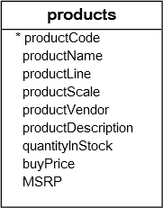
Example 2: Subqueries - WHERE Clause
‹#›
Let’s consider the products table diagram from the classicmodels database.
We can use a subquery to help us obtain all products that have a ‘buyprice’ greater than the average Product buying price - avg(buyprice).
SELECT p.productCode, p.productName ,p.buyPrice FROM products p
WHERE p.buyPrice > (SELECT AVG(pp.buyPrice) FROM products pp)

Slide 12
Example 3: Subqueries - WHERE Clause
‹#›
The following query uses the IN Operator to find employees who work in offices located in the USA.
Here is a dynamic way to select employees who work in offices located in the USA. Later, more office space locations can be added in database.
SELECT lastName, firstName FROM employees
WHERE officeCode IN (1,2,3,2200,3001)
In this example:
The inner query returns all office codes of the offices located in the USA.
The outer query selects the last name, first name, and office code for employees who work in the offices whose office codes are in the result set returned by the subquery.
SELECT lastName, firstName, officeCode
FROM employees
WHERE officeCode IN
(SELECT officeCode FROM offices WHERE country = 'USA');

Slide 13
Example 4: Subqueries - WHERE Clause
‹#›
The query below will find the customer who pays highest amount.
SELECT c.customerNumber, c.contactFirstName, checkNumber, amount, max(amount)
FROM payments p INNER JOIN customers c
on p.customerNumber = c.customerNumber
WHERE amount = (SELECT max(amount) FROM payments);

Slide 14
Subqueries - HAVING Clause
‹#›
You can use subqueries with the HAVING clause to filter out groups of records. Just as the WHERE clause is used to filter rows of records, the HAVING clause is used to filter groups. Because of this, it becomes very useful in filtering on aggregate values such as averages, summations, and counts.
Syntax : Subquery in HAVING Clause
SELECT column_name(s)
FROM table_name_1
WHERE condition
GROUP BY column_name(s)
HAVING Aggregate_function(column_name) expression_operator{ =,<,> }
(SELECT column_name(s) from table_name_2);
Notes:
A HAVING clause is used in conjunction with the GROUP BY clause to filter the select-list records that a GROUP BY returns. HAVING clause subqueries must use Boolean comparison operators: =, >, <, <>, <=, >=

Slide 15
Example 1: Subqueries - HAVING Clause
‹#›
It is possible to compare the average of a group to the overall average. We have always been able to use the average of the group in the HAVING clause, but we had no way to compute the overall average. Now, using subqueries, this is possible.
In the below example, we are selecting employees who have remaining vacation hours greater than the overall average for all employees.
SELECT firstName, AVG(VacationHours) AS AverageVacationHours
FROM employees GROUP BY employeeNumber
HAVING AVG(VacationHours) > (SELECT AVG(VacationHours) FROM employees);
The above query is executed as:
The subquery computes the remaining average vacation hours for all employees.
The outer-query groups the records by employee_id and computes the average vacation hours.
The outer-query only keeps those groups whose average vacation hours are greater than the overall average.
Notes:
Compare the average of a group to the overall average.

Slide 16
Example 2: Subqueries - HAVING Clause
‹#›
The below query will find customer name, customer number, check number, and who made a payment greater than the overall average payment.
SELECT pp.customerNumber, pp.checkNumber, pp.amount, c.customerName, AVG(pp.amount)
FROM payments pp INNER JOIN customers c USING (customerNumber)
GROUP BY pp.customerNumber
HAVING AVG(pp.amount) > ( SELECT avg(p.amount) AS avgamount FROM payments p);

Slide 17
Subqueries - FROM Clause
‹#›
Like all subqueries, those used in the FROM clause to create a derived table are enclosed by parenthesis.
A table alias is used to select specific fields out of the subquery, and is mandatory because all tables in the FROM clause must have a name in order to reference its results.
Syntax:
SELECT * FROM (subquery) AS table_name_alias
continue…

Slide 18
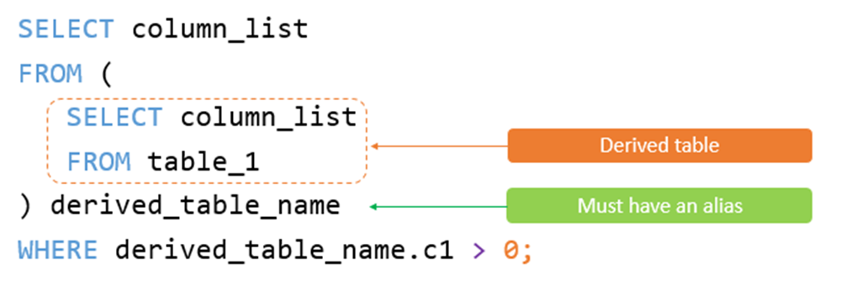
Subqueries - FROM Clause (continued)
‹#›
Subqueries with the FROM Clause are used to specify the source from which data has to be fetched. In the first case, the result of the subquery (inner query) will act as the source. In the second case, data will be fetched from table_name_1.
Syntax – Subquery in From Clause:
When subqueries are used in the FROM clause, they act as a table that you can use to select columns and join to other tables. Because of this, some people argue that they really are not subqueries, but derived tables.
Notes:
A derived table is a table expression that appears in the FROM clause of a query. You can apply derived tables when the use of column aliases is not possible because another clause is processed by the SQL translator before the alias name is known.

Slide 19
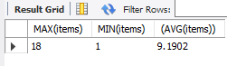
Example 1: Subqueries - FROM Clause
‹#›
The following subquery finds the maximum, minimum, and average number of items in the sale orders:
SELECT MAX(items), MIN(items), (AVG(items))
FROM (SELECT orderNumber, COUNT(orderNumber) AS items
FROM orderdetails GROUP BY orderNumber) AS lineitems;
Result:

Slide 20
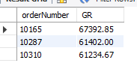
Example 2: Subqueries - HAVING and FROM Clause
HAVING subqueries can be used to generate rather sophisticated statistics. Here is a query that returns the top 10 percent of revenue-generating orders.
Notice that this subquery uses a subquery in its FROM clause – a subquery within a subquery.
SELECT orderNumber, SUM(quantityOrdered * priceEach) GR
FROM orderdetails
GROUP BY orderNumber
HAVING GR >= ( SELECT 0.9 * MAX(GR) FROM
( SELECT orderNumber, SUM(quantityOrdered * priceEach) GR FROM orderdetails GROUP BY orderNumber) as gross);
Result:

Slide 21
Correlated Subqueries
‹#›
Each subquery used in the prior examples can stand alone when run. SQL also allows us to construct subqueries, which reference table(s) in the outer query. A correlated subquery depends on the outer query.
This following query returns products with buyingprices > the average price in their product line.
SELECT productname, buyprice
FROM products p1
WHERE buyprice > (
SELECT AVG(buyprice)
FROM products
WHERE productline = p1.productline);
In contrast to stand-alone subqueries, which are executed just once, correlated subqueries must execute once for every row processed in the outer query. This can lead to poor performance.

Slide 22
Hands-On Lab
‹#›
Complete the GLAB - 304.7.1 - Subqueries. You can find this Lab on Canvas under the Assignment section.
If you have any technical questions while performing the lab activity, ask your instructors for assistance.

Slide 23
Subqueries - Data Manipulation Language
We can use subqueries with INSERT, UPDATE, and DELETE statements.
Example 1- Subquery with UPDATE: The query below will update the status to pending for USA and JAPAN customers. We will utilize the subquery with WHERE clause.
UPDATE orders SET STATUS = 'pending'
WHERE customerNumber IN ( SELECT c.customerNumber FROM customers c WHERE country IN ('USA' , 'JAPAN') )
Example 2- Subquery with UPDATE: The query below will update the status to backorder for those products that have stock of less than 40 items.
UPDATE orders SET status='Backorder'
WHERE status='In Process' AND orderNumber
IN (SELECT DISTINCT od.orderNumber FROM orderDetails od JOIN products p USING(productCode) WHERE p.quantityInStock < 40);
continue…

Slide 24
Subqueries - Data Manipulation Language (continued)
Example 3 - Subquery with UPDATE: Suppose you have to update the phone extensions of the employees who work at the office in San Francisco.
The following query adds the number “1” to the phone extensions of employees who work at the office in San Francisco.
UPDATE employees
SET extension = CONCAT(extension, '001')
WHERE EXISTS
(SELECT 1 FROM offices
WHERE city = 'San Francisco' AND offices.officeCode = employees.officeCode);
How it works.
First, the EXISTS operator in the WHERE clause gets only employees who work at the San Francisco office.
Second, the CONCAT() function concatenates the phone extension with the number ‘001.’

Slide 25
Practice Assignment
‹#›
Complete the following practice assignments:
Click here for Practice assignment: JOINs and Subqueries.
Click here for Practice assignment: Subquery Table, Derived Tables, Nested Queries.
Note: Use your office hours to complete this assignment. If you have any technical questions while performing the practice assignment activity, ask your instructors for assistance.

Slide 26
Knowledge Check
‹#›
What is a subquery in SQL?
What is a correlated subquery?
What is the difference between subqueries and SQL JOINs?
Which keyword is dependent upon the existence of the result of a query?
EXISTS
NOT EXISTS
NOT NULL
WHERE
Which of the following is not true about SQL subqueries?
They are nested queries.
They are executed first.
Only one subquery can be nested.
None of the above.

Slide 27
Section 2
___________
View
‹#›
Learning Objectives:
By the end of this lesson, learners will be able to:
Explain why we need SQL.
Explain View in SQL.
Utilize View in SQL.

Slide 28
Outline
A VIEW in SQL.
Syntax: View
Rename a View in SQL.
View Advantages.

Slide 29
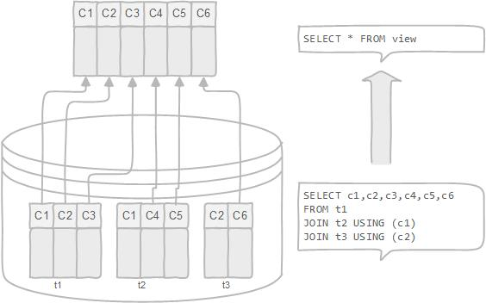
A VIEW in SQL
‹#›
An SQL VIEW is not a physical table, but rather, it is a virtual table formed by a query that joins one or more tables. When you create a view, you are essentially creating a query and giving it a name. As a result, a view is beneficial for enclosing an often-used complex query.
The SQL View is essentially a saved query in the database.

Slide 30
Syntax: A VIEW in SQL
‹#›
The CREATE VIEW statement creates a new view in the database. Here is the basic syntax of the CREATE VIEW statement:
CREATE VIEW database_name.view_name [(column_list)]
AS Select-Statement-Queries;
Note: By default, the CREATE VIEW statement creates a view in the current/selected database. If you want to explicitly create a view in a given database, you can qualify the view name with the database name.

Slide 31
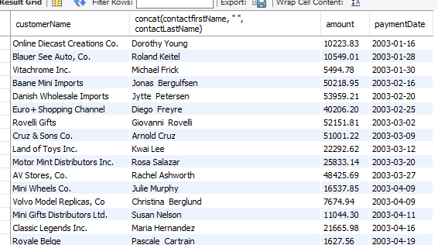

Example 1: A VIEW in SQL
‹#›
If you want to get customer payment data, you would normally construct a JOIN statement as follows:
Now, when you need to get customer payment data, query it from the VIEW by executing the following simple SELECT statement:
CREATE VIEW customer_payment AS
SELECT c.customerName, concat(contactfirstName, " ", contactLastName), p.amount, p.paymentDate
FROM customers c
INNER JOIN payments p
ON c.customerNumber = p.customerNumber
ORDER BY p.paymentDate;
SELECT * FROM customer_payment;
Result
Result: In View section

Slide 32
Rename a VIEW in SQL
‹#›
To rename a VIEW, we can use the Rename Statement. The basic syntax is:
RENAME Table <table-name> to new-table-name;
You can change the name of the VIEW from customer_payment to customer_info by using the following statement:
Rename table customer_payment to customer_info;
Remember: Since VIEWS are not physical tables, updating a View actually updates the underlying table.

Slide 33
VIEW Advantages
‹#›
A VIEW can be very useful in some cases:
It avoids repetitions. If we have a query that is used frequently, we can just store it as a view instead of formulating and running it over and over again.
We can hide business logic or complexity by using VIEWs.
We can grant permission to users through a VIEW that contains specific data that the users are authorized to see.
We can also encapsulate sensitive queries in a VIEW and limit exposure, thus increasing security.
A VIEW provides a consistent layer; even the columns of underlying table changes.
A VIEW can be used as a backup for a table when migrating.

Slide 34
Knowledge Check
What is a View in SQL?
When do you usually use Views?

Slide 35
References
‹#›
https://dev.mysql.com/doc/refman/8.0/en/subqueries.html
https://dev.mysql.com/doc/refman/8.0/en/exists-and-not-exists-subqueries.html
https://www.techonthenet.com/mariadb/exists.php#:~:text=The%20MariaDB%20EXISTS%20condition%20is,%2C%20UPDATE%2C%20or%20DELETE%20statement.

Slide 36

Questions?
‹#›

